Slide 1
Feature Engineering Project – Suspicious Objects
Abhishek Najbile and Rahim Jiwa

Slide 2
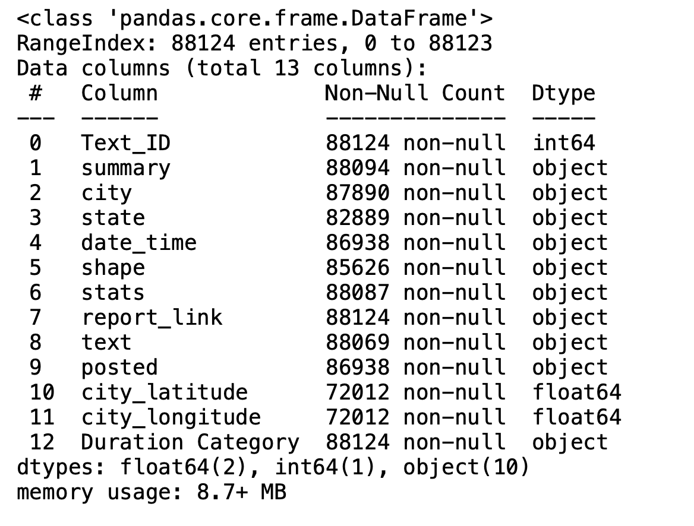
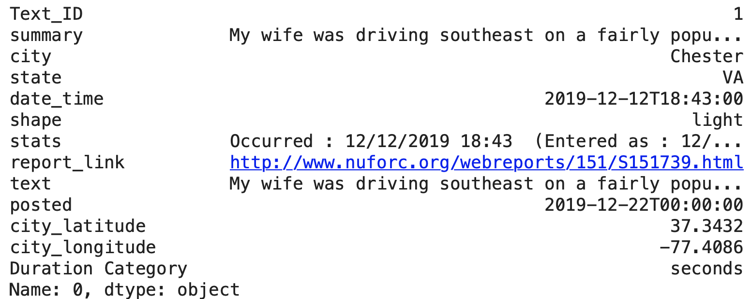
Starting Data
Our starting data contains 13 columns, of approximately 88,000 UFO sighting reports.
The types of data included: datetime, categorical, geographical, and, textual.

Slide 3
Initial Thoughts
Goal was to clean up the data and add information that may help us make sense of the sightings.
What are possible explanations for the sightings? Could there be planes or could they be seeing an astrological event (meteors or satellites)
There could be impacts on the recollection of the incident. For example, the individual could have been sleepy or intoxicated or reporting the incident way after it occurred.
Missing geographic data can be determined, missing time data can be determined.

Slide 4
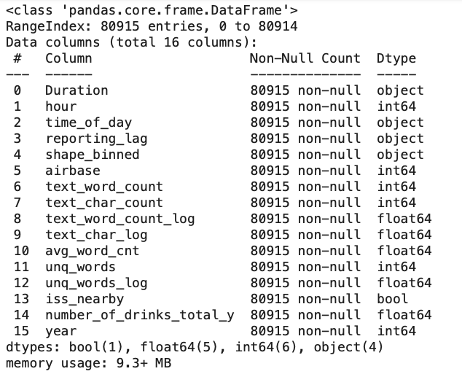
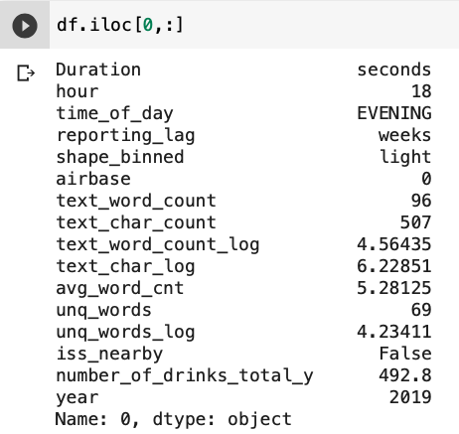
Final Features
Our final features had 16 columns and we had approximately 80900 instances.

Slide 5
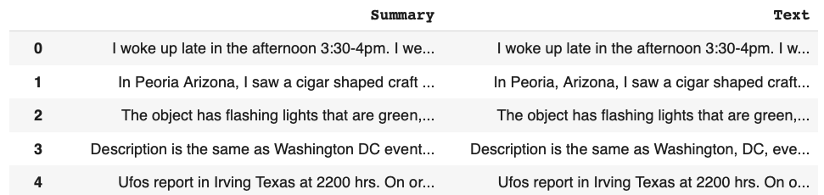
Summary/Text
Looking at the summary and text, one of the first things that jumped out is that they looked similar. Almost like the summary is just a clip or substring of the text.
To compare the text, we performed basic text processing: lower, remove punctuation, remove stopwords, lemmatize, remove notes that have been added by NUFORC.
After cleaning and comparing whether the summary string was within the text, we ran into issues for typos or minor variations saying the same thing.

Slide 6
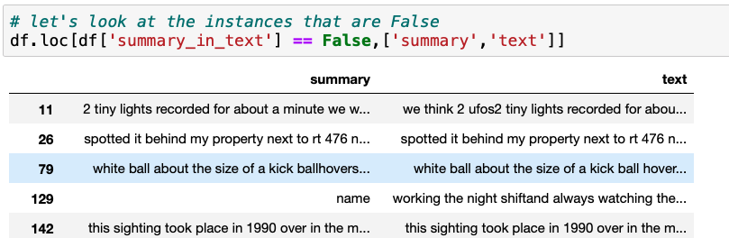
Summary/Text
In order to deal with this, we utilized fuzzy partial matching in order to get the similarity between summary and text. Found that they were similar and we could stick to text.
To extract features from text, we focused on and applied transformations to: word count, character count, number of unique words.

Slide 7
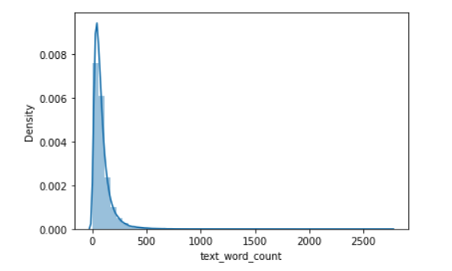
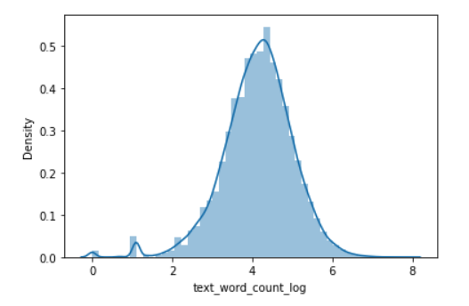
Summary/Text
Applying the log transformations to: word count, character count and unique word count resulted in more centered data.

Slide 8
Time
Times that were available: time sighting occurred, time sighting was reported and time that sighting was posted.
Features created: Hour, Year, Time of Day, Reporting Lag.
Time of day, is a categorical variable, that can act as a proxy for conditions. This was created by binning the times of occurrences.
Reporting lag, is categorical variable, that can act as a proxy for reliability of the report. This was created by binning the differences between the time the sighting occurred and the time it was reported.

Slide 9
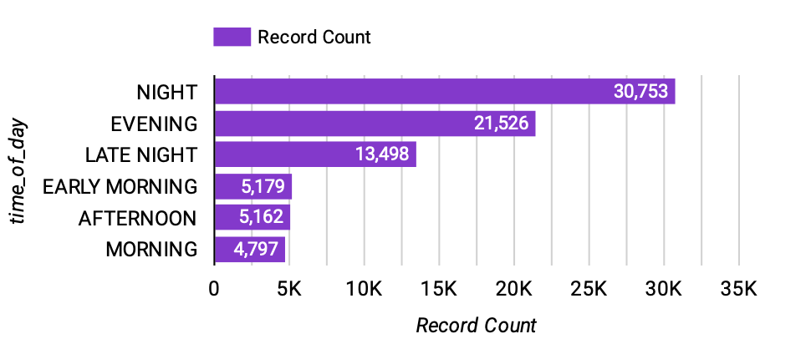
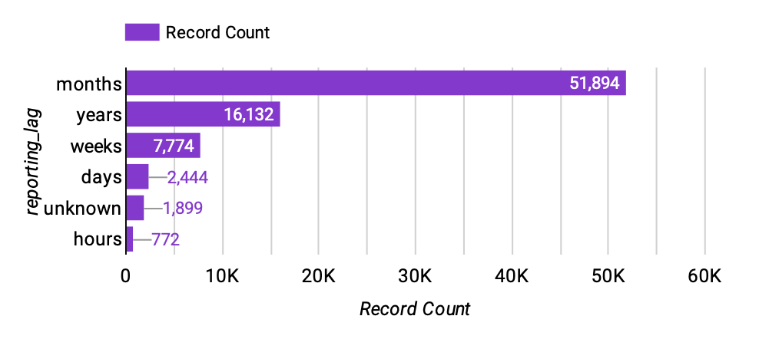
Time

Slide 10
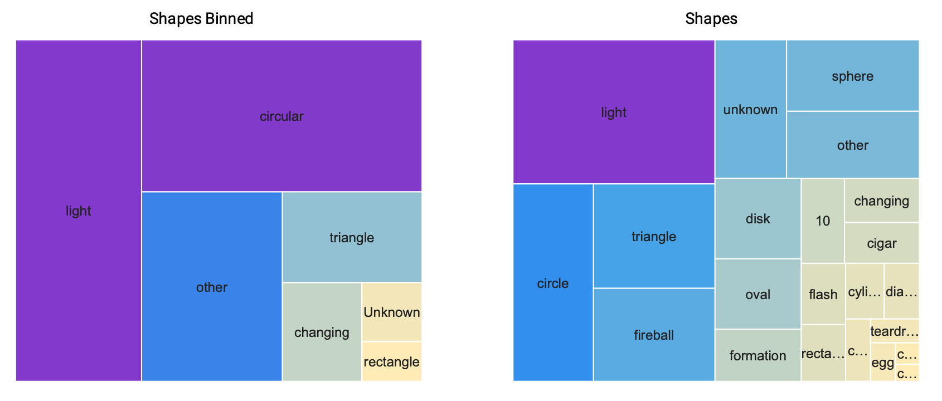
Shapes
In the data, the shape category had 21 different shapes.
A number of these shapes are equivalent. To simplify the shapes, they were binned into a smaller number of categories.

Slide 11
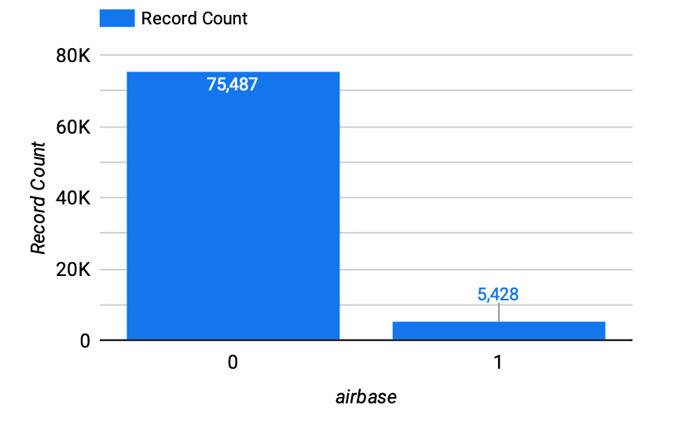
Airbases
Objective here was to determine if the State which the sighting occurred contained any airbases.
If there are airbases present, the likelihood of seeing fly objects (planes, fighter jets, missiles), increases.
To determine this, airbase data was added and then merged into the original data by the state.
Values were 0 if there are no airbases present, and 1 if the state does have airbases.

Slide 12
International Space Station (ISS) Data
A point of interest was whether we would be able to determine if there were other space or astrological elements that could be mistaken for UFOs. For example satellites or meteors.
To try this, Two Line Element data was obtained for the ISS. Then using this data, and the date given of the sightings, an approximation of the ISS coordinates was determined.
The ISS coordinates were then compared to the sightings coordinates to determine if they within a few degrees of each other. If they were, a feature iss_nearby was True, else it was False.
It was determined, that the ISS was nearby in approximately 0.002% of sightings.
An extension to this, would be to apply the same concept for other satellites and meteors and then to bring it together as an astrological phenomenon nearby rather than just the ISS.
Data was obtained from Celestrak and the Skyfield Package was used.

Slide 13
Alcohol consumption
Data was brought in to look at the alcohol consumption for the State.
This could be relevant, as most of the sightings occurred during the evening or night. If one was drinking, they would be more likely to either see something that was not there, or convince themselves that something normal was a UFO sighting.
The features that was focused on here is the total number of drinks consumed.

Slide 14
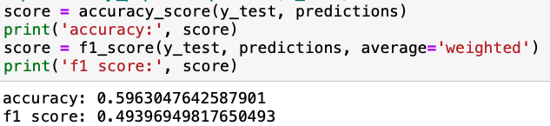
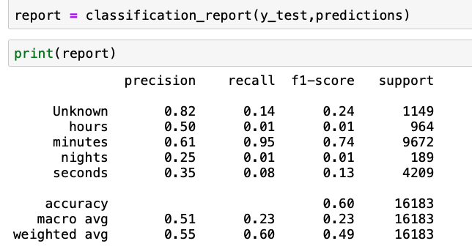
model
Utilized a Random Forest model with Grid Search in order to find the best parameters.
Obtained an accuracy of 0.60 and an f1 score of 0.49.

Slide 15
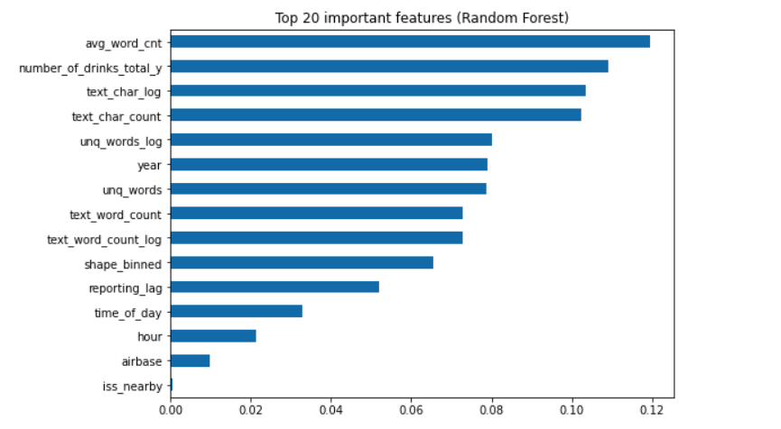
Feature Importance

Slide 16
Final Thoughts/Next Steps
Overall, happy with how it turned out.
Look for additional supplemental data: educational data, weather data, astrological data.
Refine model features and re-run model features to try to improve performance.

